Slide 1
Guide to using the
BJUI Knowledge app
Contents
Installing the app
Logging in
Navigating the app
Viewing modules
CPD profile
Support and feedback

Slide 2
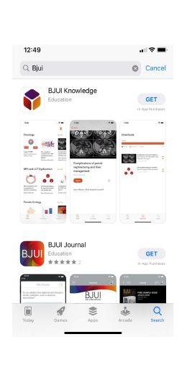
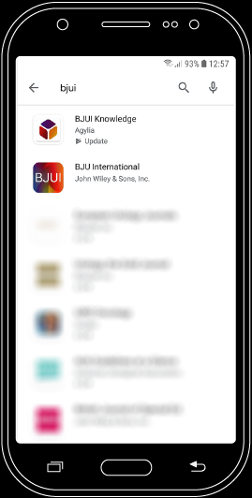
Guide to using the BJUI Knowledge app
1. Installing the app
The BJUI Knowledge app is available for most smartphones and tablets.
To download, follow one of these links from your device:
You can also search for “BJUI” in the App Store…
… or in the Google Play Store.
Apple, the Apple logo, iPhone, and iPad are trademarks of Apple Inc. App Store is a service mark of Apple Inc. Android, Google Play and the Google Play logo are trademarks of Google LLC.

Slide 3
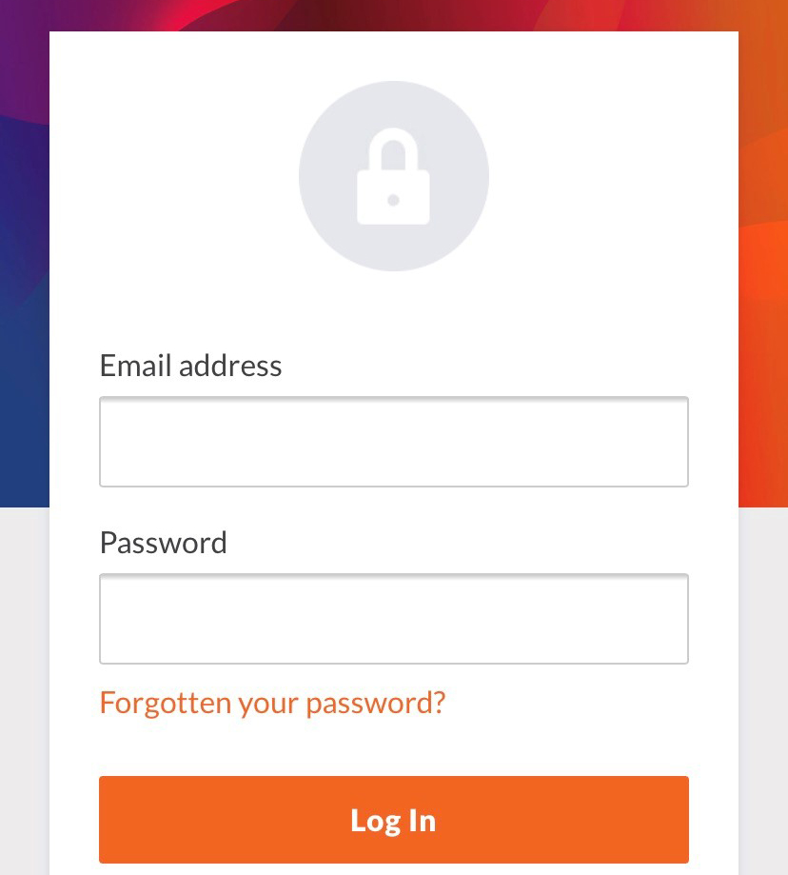
Guide to using the BJUI Knowledge app
2. Logging in
To access modules, you will need a BJUI Knowledge account and subscription. You may have a subscription through a professional urological association.
If you do not already have a BJUI Knowledge account, you can create one in the app by selecting or on our website.
Once you have created an account, or if you already have an account, you will be able to log in.
Your username will be the email address you signed up with.
Reset your password if you’ve forgotten it by selecting “Forgotten your password?”
You may read about our privacy and data policy here.

Slide 4
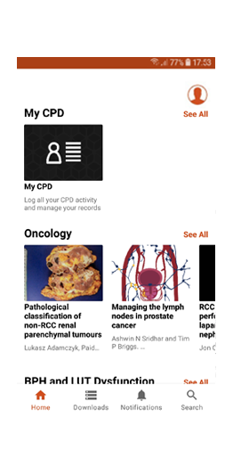
Guide to using the BJUI Knowledge app
3. Navigating the app
Immediately after you have logged in, you will be at the app “Home” screen. From Home, many things are possible.
A selection of our e-learning modules, which are organised by curriculum section, can be accessed directly from Home.
My CPD: where you can keep a record of your CPD activities. See Section 5.
Select “See All” to see all modules from a specific curriculum section.
Modules: you can navigate directly to e-learning modules by selecting their thumbnail icons.

Slide 5
Guide to using the BJUI Knowledge app
4. Information and
Navigation bar
Besides “My CPD” and e-learning modules and videos organised by category, there are also Account, Home, Downloads, Notifications and Search options.
Account: view general information about BJUI Knowledge and the app, or log out (if you are using a shared device).
Home: return to Home from other sections.
Downloads: the app may need to create a cache of data for a module. You can view and delete these caches here.
Notifications: Messages and news about the app and BJUI Knowledge appear here.
Search: quickly find modules by searching module titles or browsing oncology module subcategories.
Swipe downwards to refresh the Home screen.

Slide 6
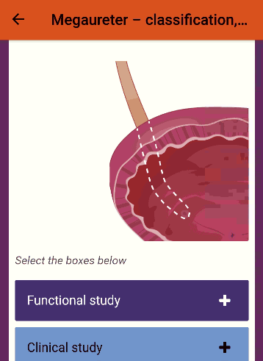
Guide to using the BJUI Knowledge app
5. Viewing modules
Interacting with modules using the app is essentially the same as using the BJUI Knowledge website.
Swipe left and right or use the arrows at the bottom of the page to navigate.
Look out for interactive elements (example on the right).
Complete the final assessment to add the module to your CPD record.
View the references and source manuscript in the resources section, if desired.
Please note:
If your device has a “back” button, pressing it will exit the module rather than moving back to the previous page.
If you are using a device with a resolution of less than 320 pixels (e.g. a smartwatch), modules may not display correctly.

Slide 7
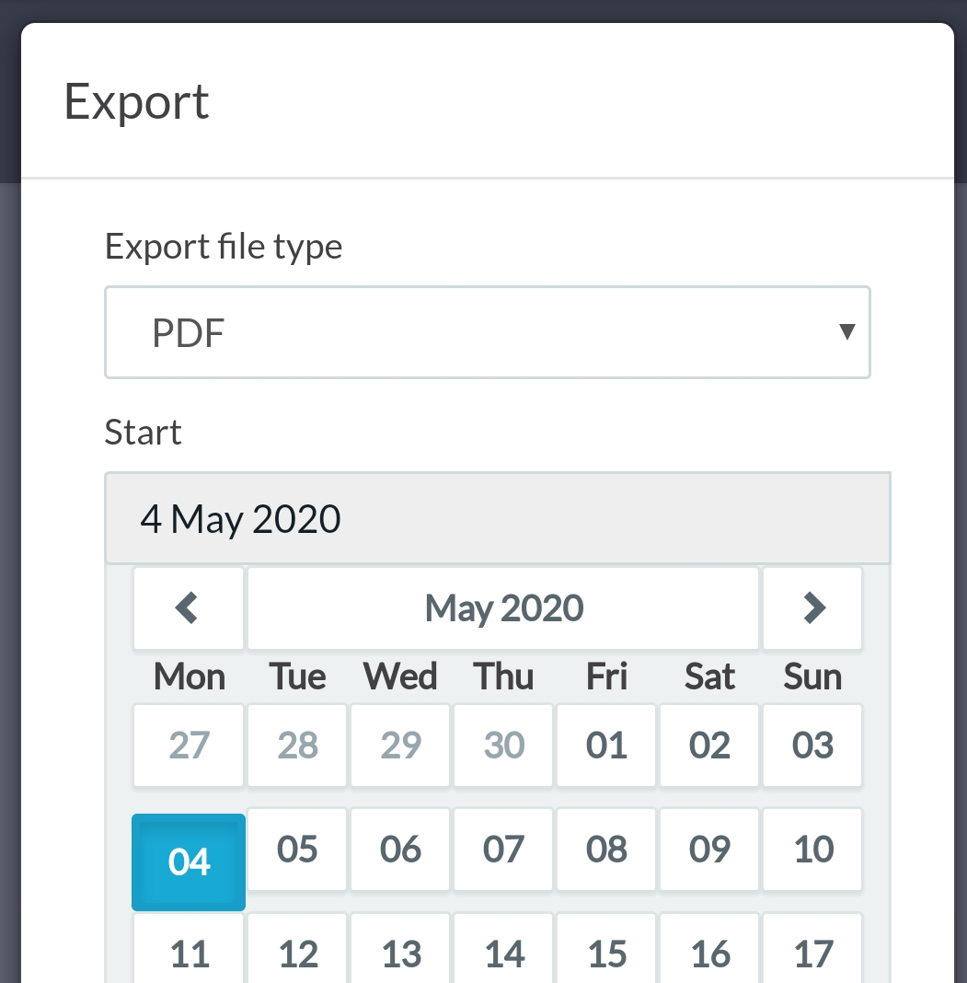
Guide to using the BJUI Knowledge app
6. My CPD
In the “My CPD” section of the app you can see the elearning modules you've completed and add other CPD activities
BJUI Knowledge is accredited by the Royal College of Surgeons of Edinburgh, The College of Surgeons of Hong Kong and the Royal Australasian College of Surgeons.
Select “Add entry” to add a CPD activity to your record.
Select “Export entries” to create a document of all your CPD activities.
Select “Help” to view a more detailed guide to “My CPD”.
You may set a custom date range before exporting the data to your chosen file type (PDF or CSV).

Slide 8
Guide to using the BJUI Knowledge app
7. Support and feedback
Our team are happy to answer any questions you have about BJUI Knowledge, the app, subscriptions and your account with us. Please contact us if you need assistance.
Email us at:
bjuiknowledge@bjui.info
In addition, we value your reviews and feedback on our app and content.
If you have feedback, please do not hesitate to:
E-mail us directly at the address above
Leave feedback at the end of a specific module, or
Leave a review on the App Store or Google Play Store.

